Slide 1
OA3103: Data Analysis
MLR Continued: Truth + Error Representation and Residual Analysis

Slide 2
Let’s Re-Cage
Setting expectations
We are not in a hurry

Slide 3
Back to R and Python

Slide 4
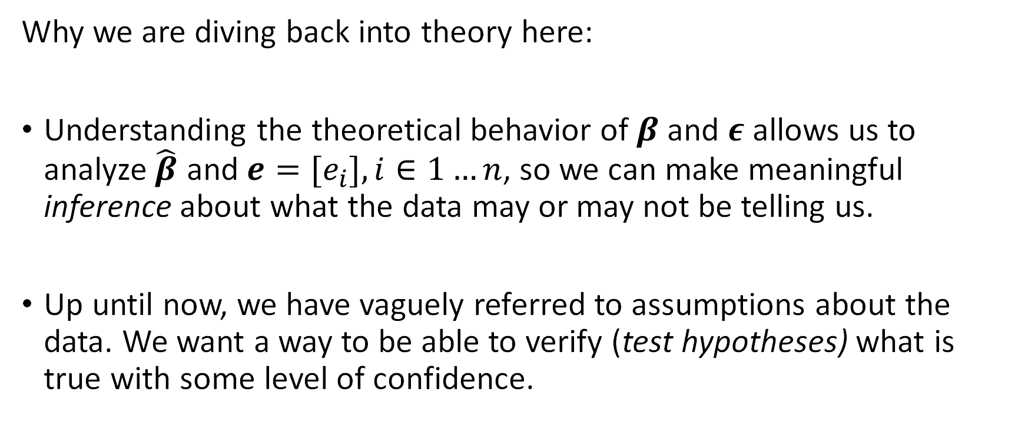
Truth + Error Representation
Why we are diving back into theory here:
Understanding the theoretical behavior of $β$and $ε$ allows us to analyze $\hat{β}$ and ${e=[e}_{i}], i∈1…n$, so we can make meaningful inference about what the data may or may not be telling us.
Up until now, we have vaguely referred to assumptions about the data. We want a way to be able to verify (test hypotheses) what is true with some level of confidence.

Slide 5

Truth + Error Representation
If we fix the design matrix $X$and let $Y$ vary randomly,
Where does the randomness come from?
$$Y=Xβ+ε$$

Slide 6
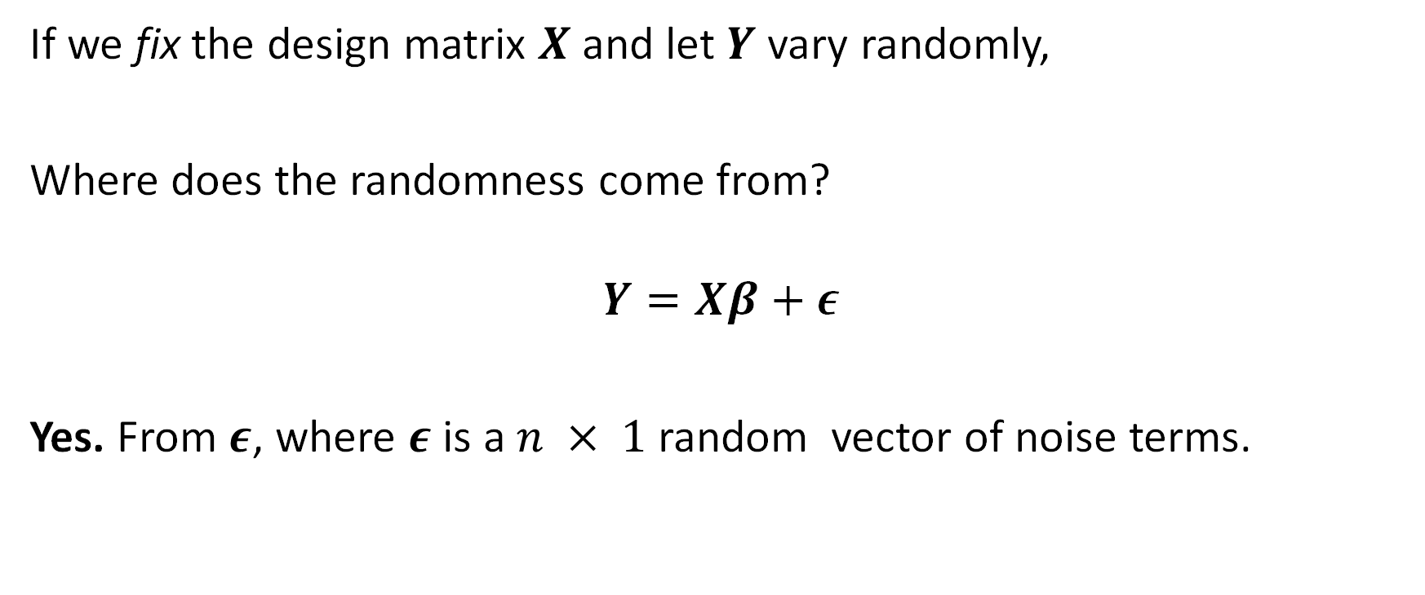
Truth + Error Representation
If we fix the design matrix $X$and let $Y$ vary randomly,
Where does the randomness come from?
$$Y=Xβ+ε$$
Yes. From $ε$, where $ε$ is a $n × 1$ random vector of noise terms.

Slide 7

Truth + Error Representation
First, let’s look at the behavior of $β$ and $\hat{β}$.

Slide 8

Truth + Error Representation
$$Y=Xβ+ε$$
$ε$ is a $n × 1$ random vector of noise terms, and
$$\hat{β}={\left(X^{T}X\right)}^{−1}X^{T}Y.$$
Then we can rewrite $\hat{β}$ as…

Slide 9
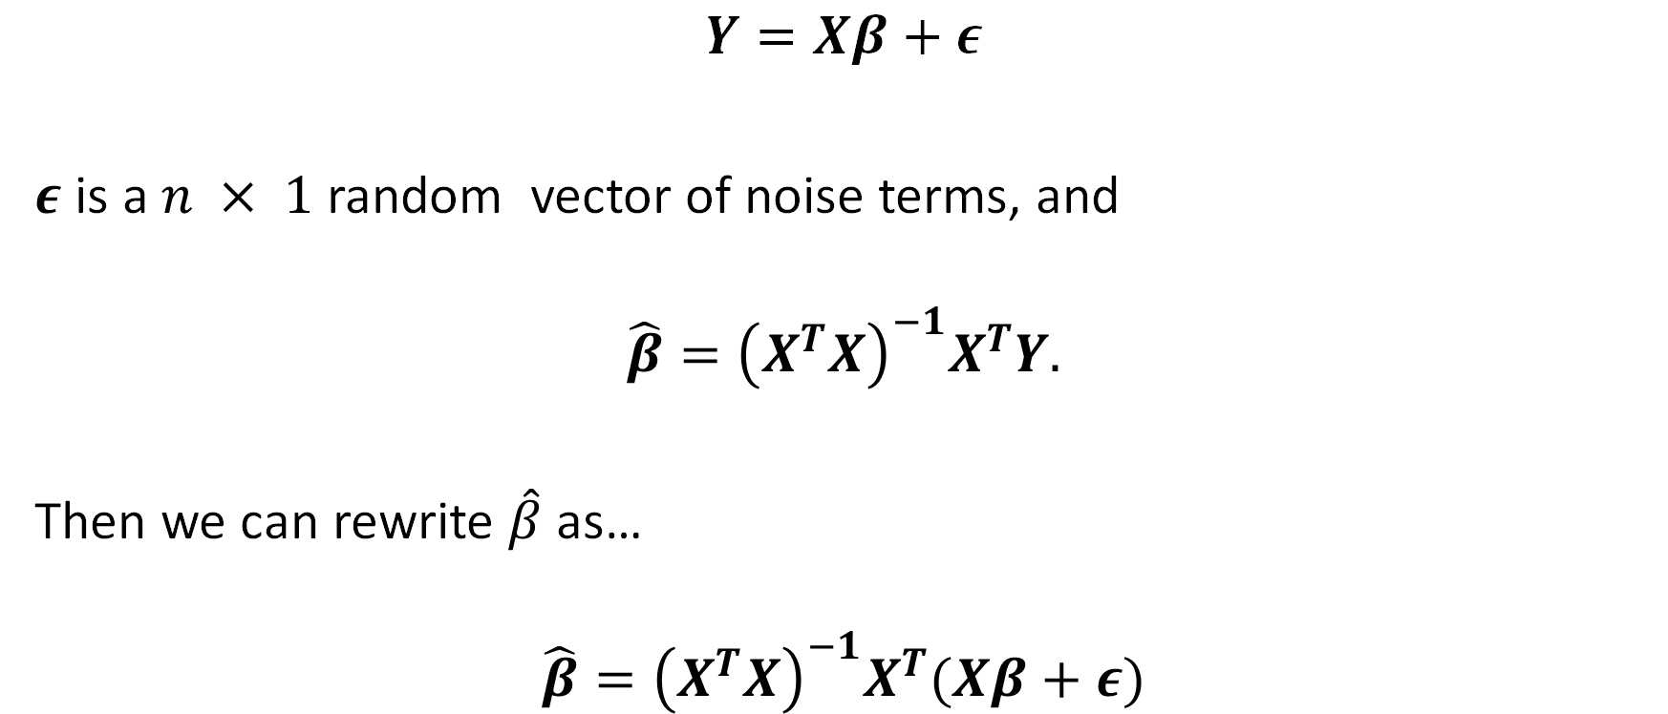

Truth + Error Representation
$$Y=Xβ+ε$$
$ε$ is a $n × 1$ random vector of noise terms, and
$$\hat{β}={\left(X^{T}X\right)}^{−1}X^{T}Y.$$
Then we can rewrite $\hat{β}$ as…
$$\hat{β}={\left(X^{T}X\right)}^{−1}X^{T}(Xβ+ε)$$

Slide 10


Truth + Error Representation
Then we can rewrite $\hat{β}$ as…
$$\hat{β}={\left(X^{T}X\right)}^{−1}X^{T}(Xβ+ε)$$
When we distribute, we get:

Slide 11

Truth + Error Representation
Then we can rewrite $\hat{β}$ as…
$$\hat{β}={\left(X^{T}X\right)}^{−1}X^{T}(Xβ+ε)$$
When we distribute, we get:
$$\hat{β}={\left(X^{T}X\right)}^{−1}X^{T}Xβ+{\left(X^{T}X\right)}^{−1}X^{T}ε$$

Slide 12


Truth + Error Representation
$$\hat{β}={\left(X^{T}X\right)}^{−1}X^{T}Xβ+{\left(X^{T}X\right)}^{−1}X^{T}ε$$
And this simplifies to:
$$\hat{β}=β+{\left(X^{T}X\right)}^{−1}X^{T}ε$$

Slide 13

Truth + Error Representation
$$\hat{β}={\left(X^{T}X\right)}^{−1}X^{T}Xβ+{\left(X^{T}X\right)}^{−1}X^{T}ε$$
And this simplifies to:
$$\hat{β}=β+{\left(X^{T}X\right)}^{−1}X^{T}ε$$
Question 1: What does this equation say?

Slide 14
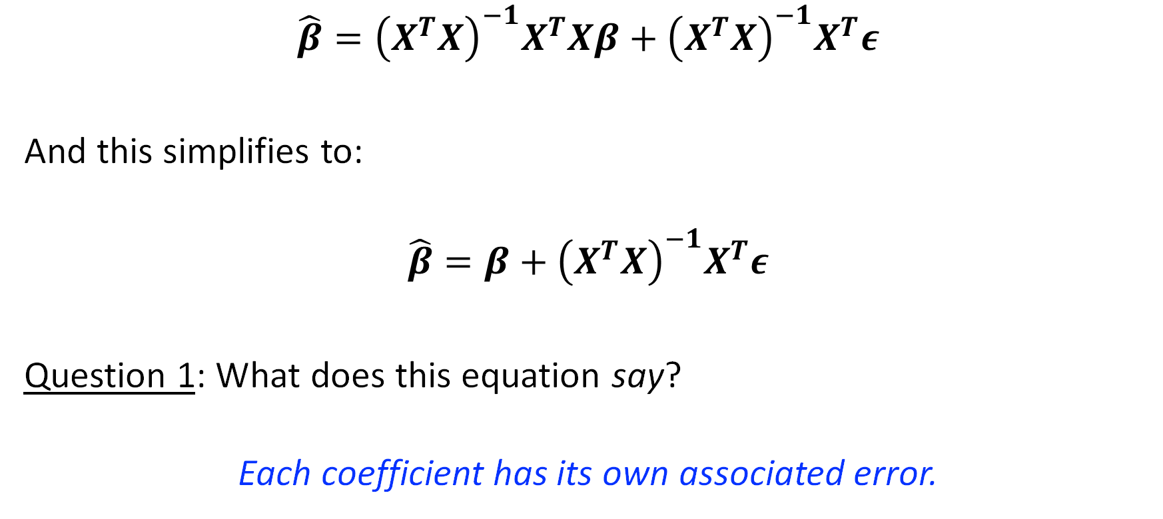
Truth + Error Representation
$$\hat{β}={\left(X^{T}X\right)}^{−1}X^{T}Xβ+{\left(X^{T}X\right)}^{−1}X^{T}ε$$
And this simplifies to:
$$\hat{β}=β+{\left(X^{T}X\right)}^{−1}X^{T}ε$$
Question 1: What does this equation say?
Each coefficient has its own associated error.

Slide 15
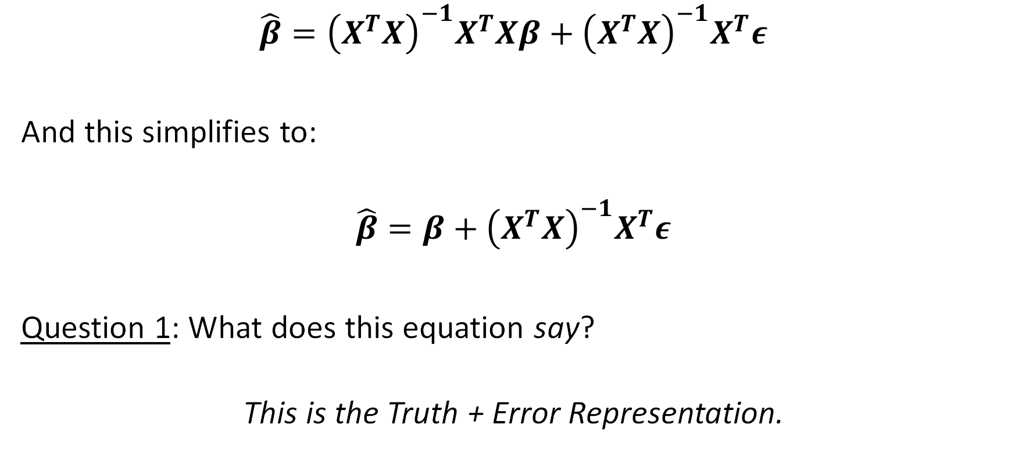
Truth + Error Representation
$$\hat{β}={\left(X^{T}X\right)}^{−1}X^{T}Xβ+{\left(X^{T}X\right)}^{−1}X^{T}ε$$
And this simplifies to:
$$\hat{β}=β+{\left(X^{T}X\right)}^{−1}X^{T}ε$$
Question 1: What does this equation say?
This is the Truth + Error Representation.

Slide 16
Truth + Error Representation
The Truth + Error Representation is convenient for us.
For example, we can ask our next question:

Slide 17
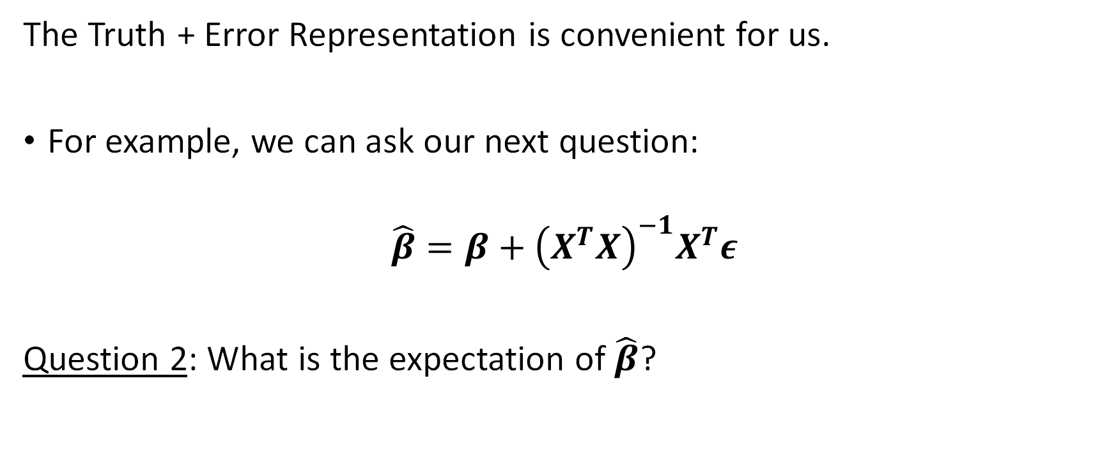
Truth + Error Representation
The Truth + Error Representation is convenient for us.
For example, we can ask our next question:
$$\hat{β}=β+{\left(X^{T}X\right)}^{−1}X^{T}ε$$
Question 2: What is the expectation of $\hat{β}$?

Slide 18
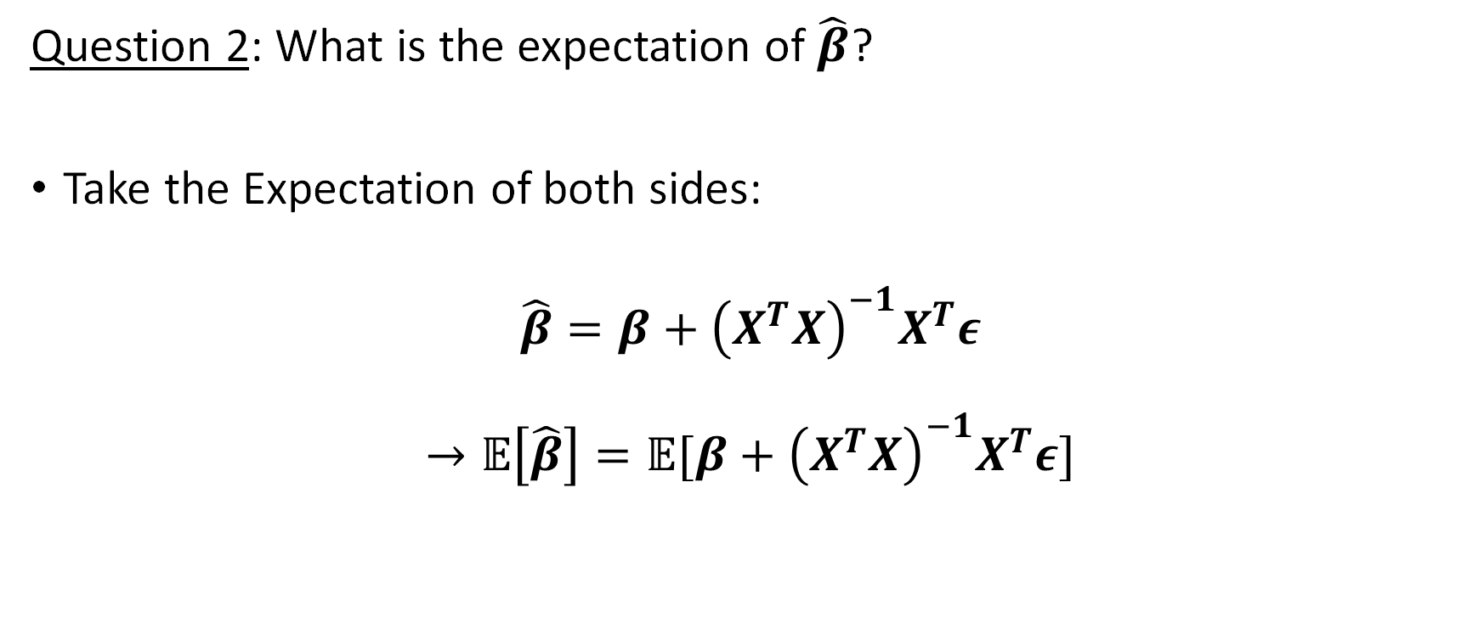
Truth + Error Representation
Question 2: What is the expectation of $\hat{β}$?
Take the Expectation of both sides:
$$\hat{β}=β+{\left(X^{T}X\right)}^{−1}X^{T}ε$$
$$→𝔼\left[\hat{β}\right]=𝔼[β+{\left(X^{T}X\right)}^{−1}X^{T}ε]$$

Slide 19
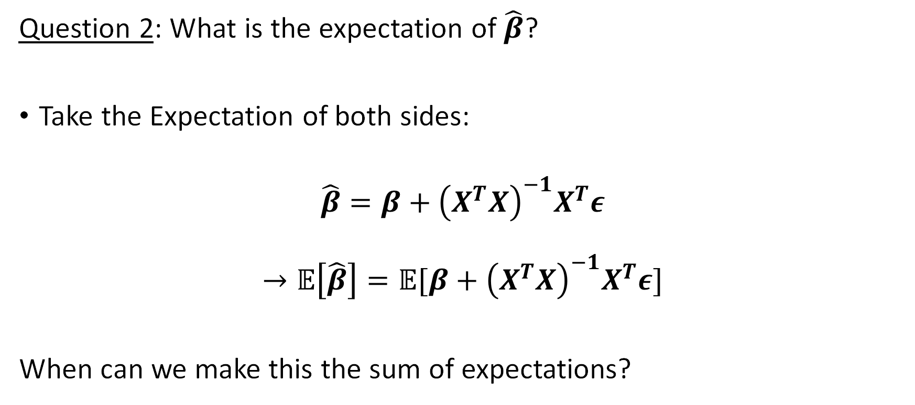

Truth + Error Representation
Question 2: What is the expectation of $\hat{β}$?
Take the Expectation of both sides:
$$\hat{β}=β+{\left(X^{T}X\right)}^{−1}X^{T}ε$$
$$→𝔼\left[\hat{β}\right]=𝔼[β+{\left(X^{T}X\right)}^{−1}X^{T}ε]$$
When can we make this the sum of expectations?

Slide 20
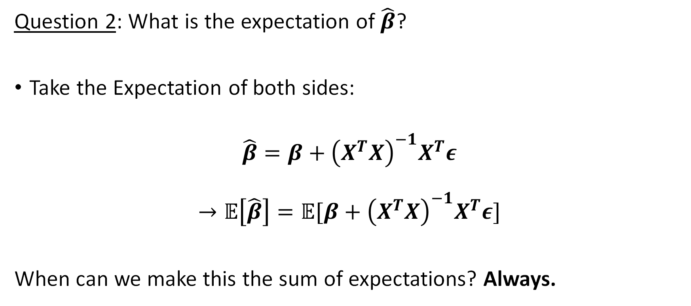
Truth + Error Representation
Question 2: What is the expectation of $\hat{β}$?
Take the Expectation of both sides:
$$\hat{β}=β+{\left(X^{T}X\right)}^{−1}X^{T}ε$$
$$→𝔼\left[\hat{β}\right]=𝔼[β+{\left(X^{T}X\right)}^{−1}X^{T}ε]$$
When can we make this the sum of expectations? Always.

Slide 21

Truth + Error Representation
Question 2: What is the expectation of $\hat{β}$?
So we get:
$$𝔼\left[\hat{β}\right]=𝔼\left[β+{\left(X^{T}X\right)}^{−1}X^{T}ε\right]$$
$$=𝔼\left[β\right]+𝔼\left[{\left(X^{T}X\right)}^{−1}X^{T}ε\right]$$

Slide 22
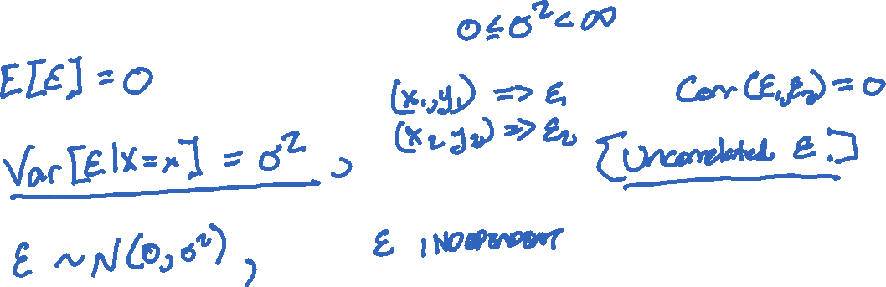
Recall our “Big Three” Assumptions
In order of preference / strength:
1.
2.
3.

Slide 23
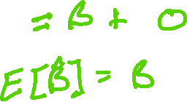
Truth + Error Representation
Question 2: What is the expectation of $\hat{β}$?
So we get:
$$𝔼\left[\hat{β}\right]=𝔼\left[β+{\left(X^{T}X\right)}^{−1}X^{T}ε\right]$$
$$=𝔼\left[β\right]+𝔼\left[{\left(X^{T}X\right)}^{−1}X^{T}ε\right]$$

Slide 24
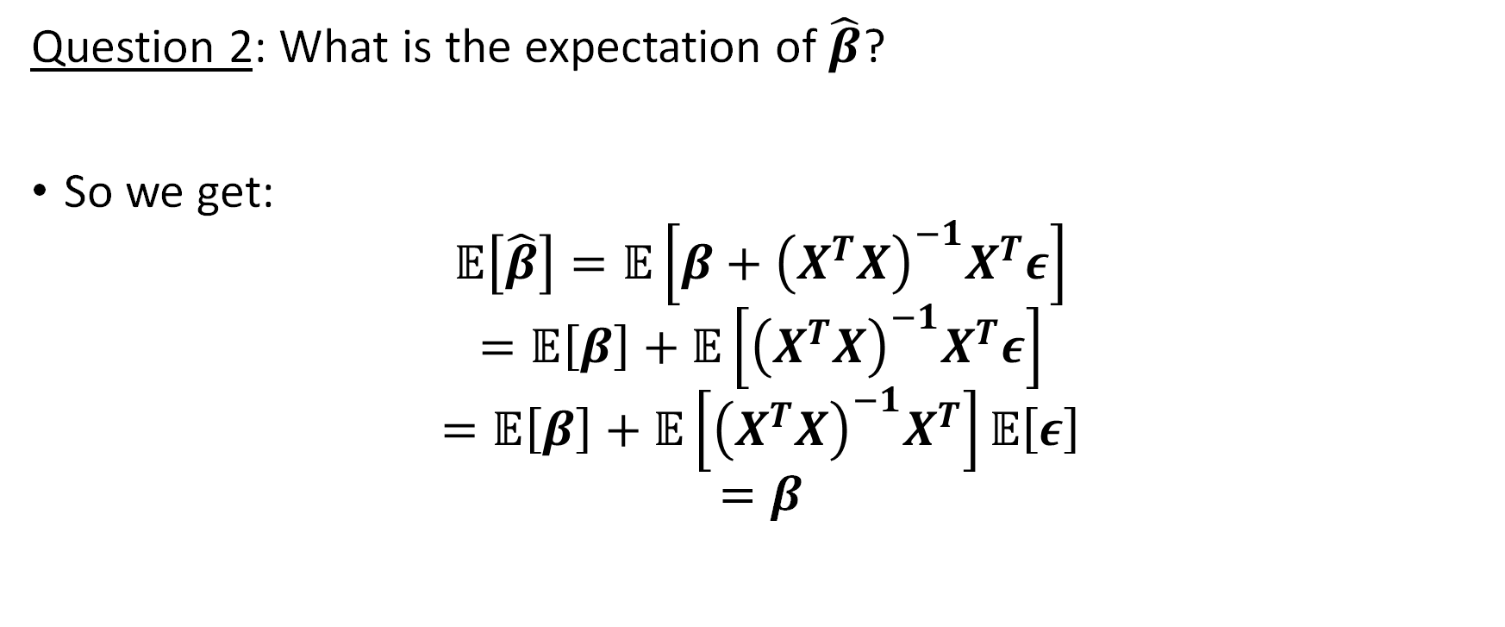
Truth + Error Representation
Question 2: What is the expectation of $\hat{β}$?
So we get:
$$𝔼\left[\hat{β}\right]=𝔼\left[β+{\left(X^{T}X\right)}^{−1}X^{T}ε\right]$$
$$=𝔼\left[β\right]+𝔼\left[{\left(X^{T}X\right)}^{−1}X^{T}ε\right]$$
$$=𝔼\left[β\right]+𝔼\left[{\left(X^{T}X\right)}^{−1}X^{T}\right]𝔼\left[ε\right]$$
$$=β$$

Slide 25


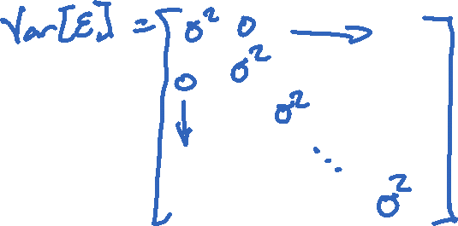
Variance of $\hat{β}$
We conclude that $\hat{β}$ is unbiased.
Next we look at the variance of $\hat{β}$:
Assume $Var\left[ε\right]=σ^{2}I_{n×n}$.
We use the 2nd assumption.

Slide 26


Variance of $\hat{β}$
Assume $Var\left[ε\right]=σ^{2}I_{n×n}$.
$$\hat{β}=β+{\left(X^{T}X\right)}^{−1}X^{T}ε$$
so
$$Var[\hat{β}]=Var\left[β+{\left(X^{T}X\right)}^{−1}X^{T}ε\right]$$

Slide 27


Variance of a Linear Transformation
Recall:
$$Var\left[aY\right]=$$
An extension of this in matrix – vector form is:
$$Var\left(AY\right)=A Var\left[Y\right] A^{T}$$
where $Y$is $m × 1$ and $A$is $n × m$.

Slide 28


Variance of $\hat{β}$
Assume $Var\left[ε\right]=σ^{2}I_{n×n}$.
$$\hat{β}=β+{\left(X^{T}X\right)}^{−1}X^{T}ε$$
so
$$Var[\hat{β}]=Var\left[{\left(X^{T}X\right)}^{−1}X^{T}ε\right]$$
$$={\left(X^{T}X\right)}^{−1}X^{T}Var\left[ε\right]{\left({\left(X^{T}X\right)}^{−1}X^{T}\right)}^{T}$$

Slide 29


Variance of $\hat{β}$
Assume $Var\left[ε\right]=σ^{2}I_{n×n}$.
$$\hat{β}=β+{\left(X^{T}X\right)}^{−1}X^{T}ε$$
so
$$Var[\hat{β}]=Var\left[{\left(X^{T}X\right)}^{−1}X^{T}ε\right]$$
$$={\left(X^{T}X\right)}^{−1}X^{T}σ^{2}I_{ }{\left({\left(X^{T}X\right)}^{−1}X^{T}\right)}^{T}$$

Slide 30

Variance of $\hat{β}$
Assume $Var\left[ε\right]=σ^{2}I_{n×n}$.
$$\hat{β}=β+{\left(X^{T}X\right)}^{−1}X^{T}ε$$
so
$$Var[\hat{β}]=Var\left[{\left(X^{T}X\right)}^{−1}X^{T}ε\right]$$
$$=σ^{2}{\left(X^{T}X\right)}^{−1}X^{T}{\left({\left(X^{T}X\right)}^{−1}X^{T}\right)}^{T}$$

Slide 31


Variance of $\hat{β}$
Assume $Var\left[ε\right]=σ^{2}I_{n×n}$.
$$\hat{β}=β+{\left(X^{T}X\right)}^{−1}X^{T}ε$$
so
$$Var[\hat{β}]=Var\left[{\left(X^{T}X\right)}^{−1}X^{T}ε\right]$$
$$={σ^{2}\left(X^{T}X\right)}^{−1} X^{T}X{{\left(X^{T}X\right)}^{−1}}^{T}$$

Slide 32

Variance of $\hat{β}$
Assume $Var\left[ε\right]=σ^{2}I_{n×n}$.
$$\hat{β}=β+{\left(X^{T}X\right)}^{−1}X^{T}ε$$
so
$$Var[\hat{β}]=Var\left[{\left(X^{T}X\right)}^{−1}X^{T}ε\right]$$
$$={σ^{2}\left(X^{T}X\right)}^{−1}$$

Slide 33









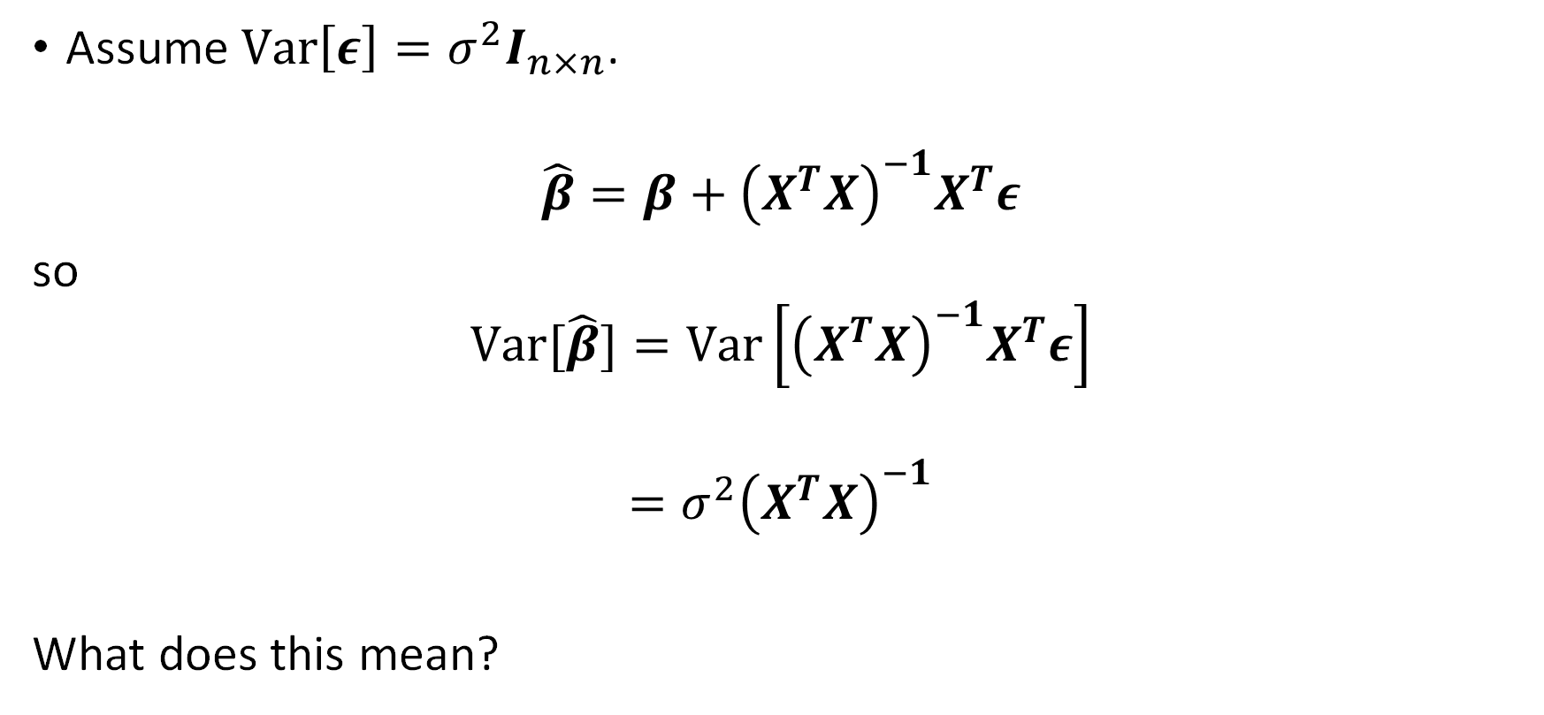

Variance of $\hat{β}$
Assume $Var\left[ε\right]=σ^{2}I_{n×n}$.
$$\hat{β}=β+{\left(X^{T}X\right)}^{−1}X^{T}ε$$
so
$$Var[\hat{β}]=Var\left[{\left(X^{T}X\right)}^{−1}X^{T}ε\right]$$
$$={σ^{2}\left(X^{T}X\right)}^{−1}$$
What does this mean?

Slide 34
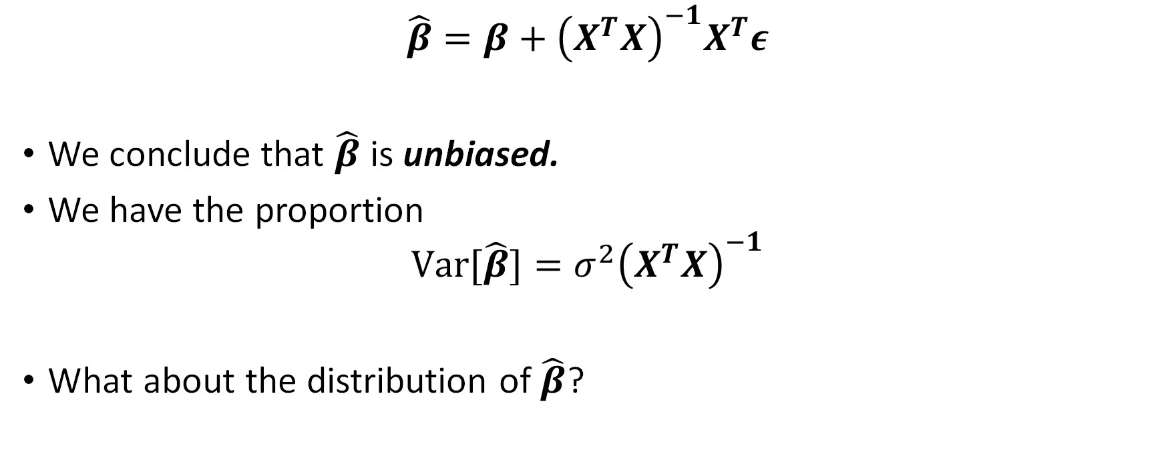

Takeaways for $\hat{β}$ continued
$$\hat{β}=β+{\left(X^{T}X\right)}^{−1}X^{T}ε$$
We conclude that $\hat{β}$ is unbiased.
We have the proportion
$$Var[\hat{β}]={σ^{2}\left(X^{T}X\right)}^{−1}$$
What about the distribution of $\hat{β}$?

Slide 35


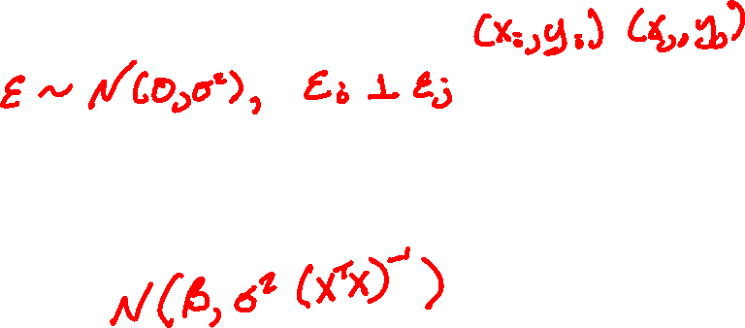
Distribution of $\hat{β}$
$$\hat{β}=β+{\left(X^{T}X\right)}^{−1}X^{T}ε$$
Third assumption:
Then, since $\hat{β}$ is a linear transformation of $ε,$
$\hat{β}\sim$

Slide 36
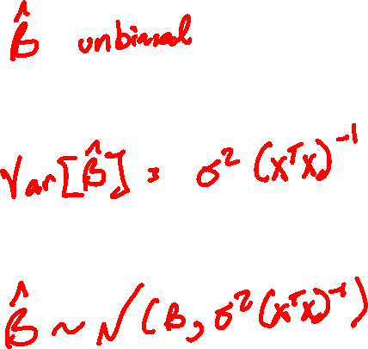
Takeaways

Slide 37


The Residual Vector
Let’s establish similar properties for the residual vector $e={\left[e_{1},…,e_{n}\right]}^{T}$.
$$e=Y−\hat{Y}=Xβ+ε−X\hat{β}$$
$e={\left[e_{1},…,e_{n}\right]}^{T}$ is a compact way of writing $e=\left[\begin{matrix}e_{1} \\ ⋮ \\ e_{n}\end{matrix}\right]$

Slide 38

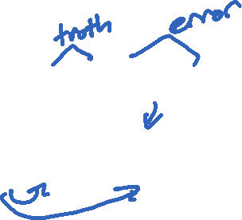
The Residual Vector
Using the truth + error representation:
$$e=Xβ−X\hat{β}+ε$$
$$=Xβ−X\left(β+{\left(X^{T}X\right)}^{−1}X^{T}ε\right)+ε$$

Slide 39


The Residual Vector
Using the truth + error representation:
$$e=Xβ−X\hat{β}+ε$$
$$=Xβ−X\left(β+{\left(X^{T}X\right)}^{−1}X^{T}ε\right)+ε$$
$$=Xβ−Xβ−X{\left(X^{T}X\right)}^{−1}X^{T}ε+ε$$

Slide 40


The Residual Vector
Using the truth + error representation:
$$e=Xβ−X\hat{β}+ε$$
$$=Xβ−X\left(β+{\left(X^{T}X\right)}^{−1}X^{T}ε\right)+ε$$
$$=ε−X{\left(X^{T}X\right)}^{−1}X^{T}ε$$

Slide 41

The Residual Vector
Using the truth + error representation:
$$e=Xβ−X\hat{β}+ε$$
$$=Xβ−X\left(β+{\left(X^{T}X\right)}^{−1}X^{T}ε\right)+ε$$
$$=ε−Hε$$

Slide 42
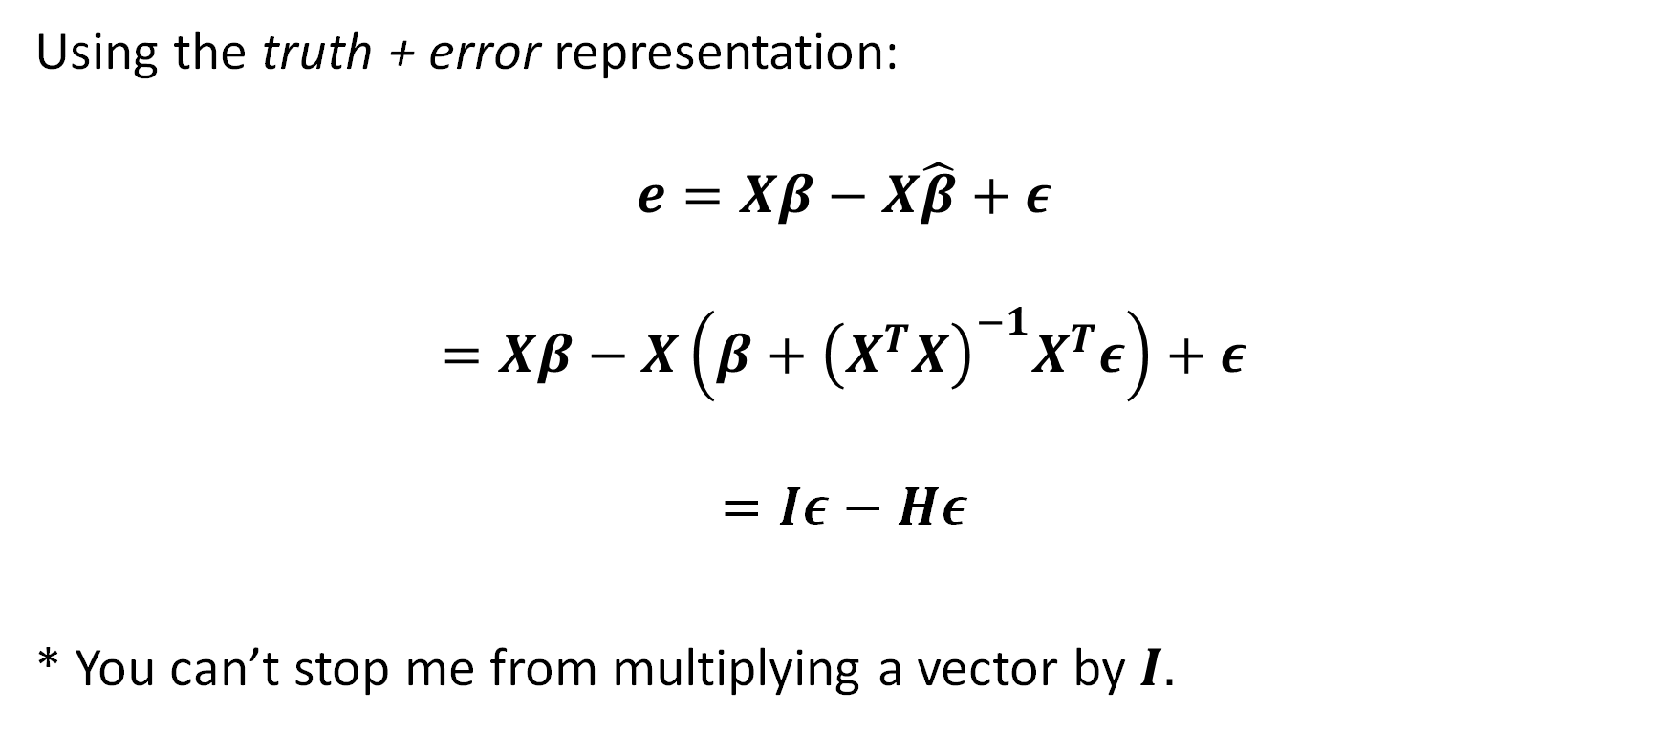

The Residual Vector
Using the truth + error representation:
$$e=Xβ−X\hat{β}+ε$$
$$=Xβ−X\left(β+{\left(X^{T}X\right)}^{−1}X^{T}ε\right)+ε$$
$$=Iε−Hε$$
* You can’t stop me from multiplying a vector by $I.$

Slide 43


The Residual Vector
So we have:
$$e=\left(I−H\right)ε$$
Another fact: If $H$is an orthogonal projection (______________ and _____________), then so is $I−H$.

Slide 44

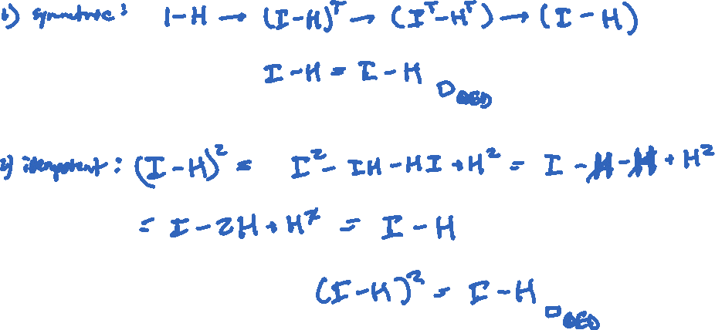
Quick Tangent
Let’s show that $I−H$ is an orthogonal projection.

Slide 45

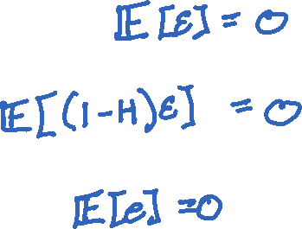
The Residual Vector
$$e=\left(I−H\right)ε$$
Therefore:
First assumption on $ε$:
So $𝔼\left[e\right]=$

Slide 46


The Residual Vector
$$e=\left(I−H\right)ε$$
Therefore:
Second assumption on $ε$:
So $Var\left[e\right]= Var\left[\left(I−H\right)ε\right]$
$=$

Slide 47

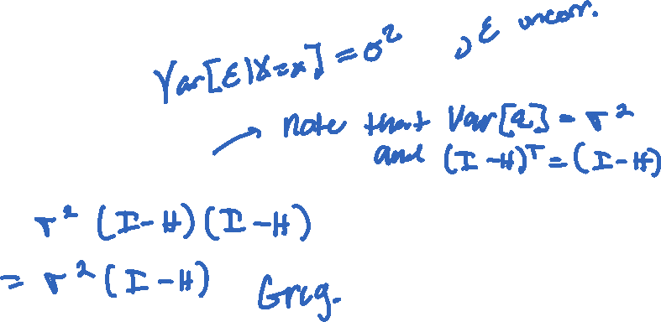
The Residual Vector
$$e=\left(I−H\right)ε$$
Therefore:
Second assumption on $ε$:
So $Var\left[e\right]=\left(I−H\right) Var\left[ε\right]{\left(I−H\right)}^{T}$
$=$

Slide 48

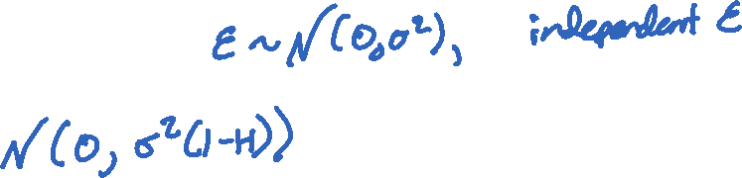
The Residual Vector
$$e=\left(I−H\right)ε$$
Therefore:
Third assumption on $ε$:
So $e\sim$

Slide 49

The Residual Vector
These results suggest that we can verify modeling assumptions by looking at properties of the residuals.
$e$has mean zero for each $x$ suggests $ε$ has mean zero.
$e$is homoskedastic suggests $ε$ has constant variance $σ^{2}$.
$e is approx.$ normally distributed suggests $ε\sim N(0,σ^{2})$.

Slide 50

The Takeaways
We can look at the behavior of the coefficients $\hat{β}$.
They are unbiased estimators of the true (unknown) $β$.
We can use the residuals to estimate the variance of $β.$
This means: We can meaningfully estimate how far off of $β$ we are.
We can look at the residuals and it will tell us whether we truly meet the assumptions we’ve made.
These are called diagnostics. We are doing a “health check” of the assumptions by looking at the residuals.

Slide 51

Examples

Slide 52

Examples

